Slide 1
Online Examination System
Submitted To: Dr. Manoj Varshney

Slide 2
Submitted By
Sachi Tripathi (181500598)
Shikha Parashar (181500661)
Satyam Kumar Jha (181500627)

Slide 3
Objective
To build an Online Examination System which takes exam of students and displays the results according to the answers given by the student.

Slide 4
Introduction
It is an online examination system to test the skills and knowledge acquired by the students during the tenure of their studies.
This mainly focuses on building a web based examination portal.
As we are heading towards digital world, this can be a better way of taking examinations.
More convenient than older ways for students as well as for teachers.

Slide 5
Features
Interactive and user friendly design
Simple and easy to take examination
Modification is easy

Slide 6
Technologies Used
React JS
Node JS
Express JS
JavaScript
HTML
CSS

Slide 7
Scope
The project developed is a web application having front end as well as back end features.
The aim of this project is to provide a platform to the students for giving examinations.
These type of applications are much useful in current scenario.
It is need of the hour to make such platforms to make things convenient.

Slide 8
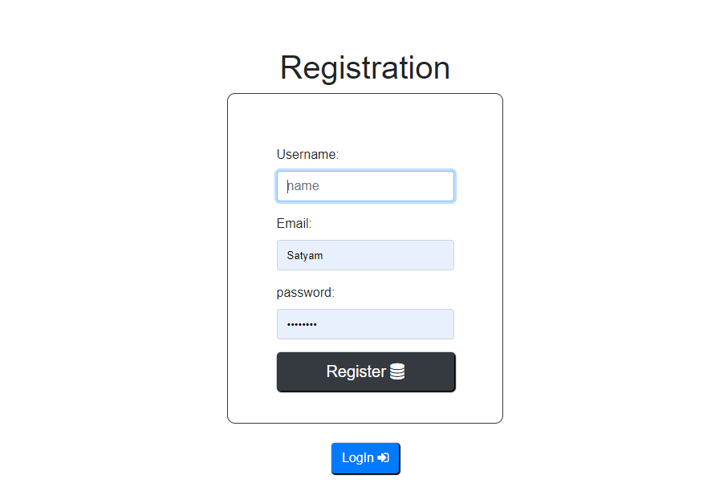
User Interfaces
Registration Page
As soon as the user land on the portal, registration page is displayed.
It shows up when a user either tries to take the exam without logging in or logs out after giving the exam.
This form has three fields and a button to register.
First field is to enter Username, second is for email and third one is to set the desired password.
If the user already has an account he/she can directly login through one more button on the same page.

Slide 9
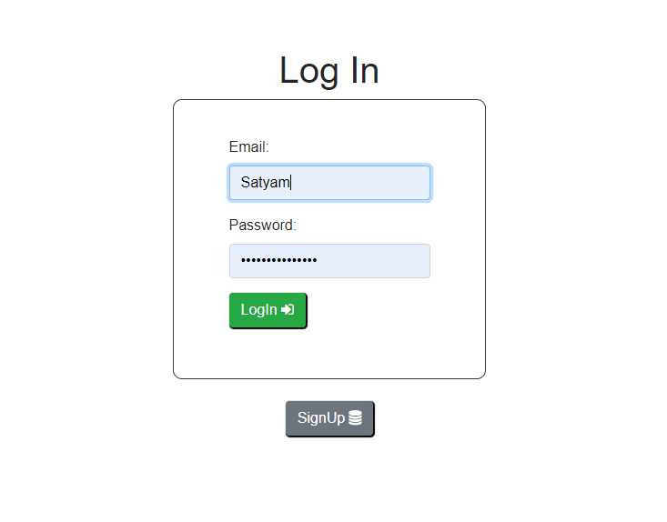
User Interfaces
Login Page
This page is displayed to the user either after completing the registration or by clicking on the login button on registration page.
It has a login for with two fields one for entering email and another for entering the password with a button to login and one more to go back to signup/registration page.

Slide 10
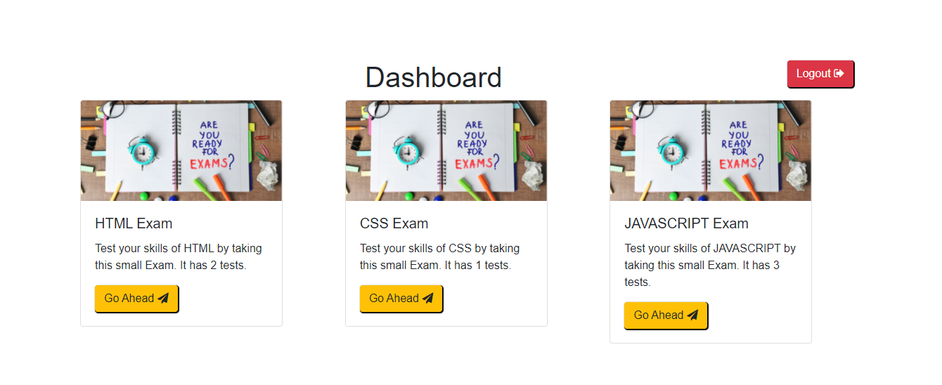
User Interfaces
Dashboard
Once the user is done with all the process of registration and logging in he lands up to the dashboard.
It displays a list of thumbnails mentioning list of subjects with a button to proceed further.
On the top-right corner there is a button to logout from the dashboard.

Slide 11
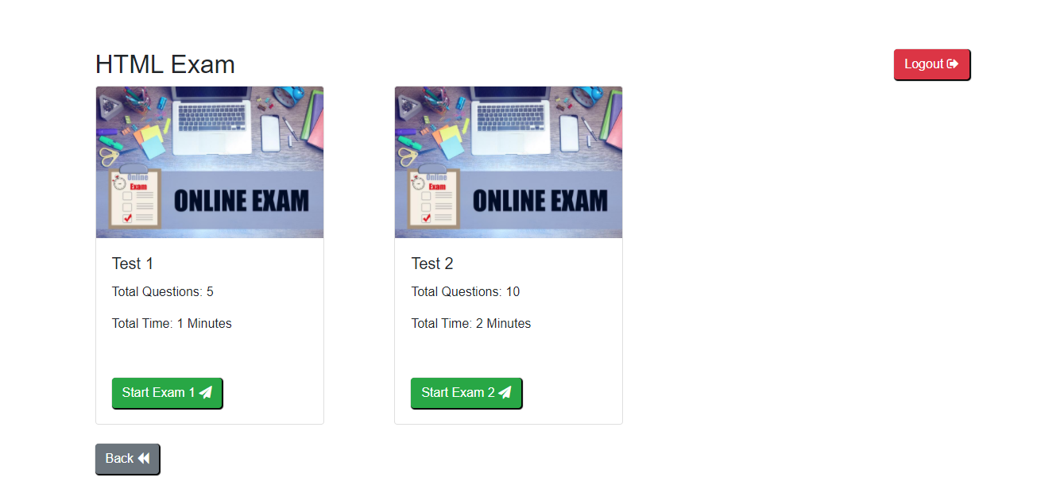
User Interfaces
Take Exam Page
This page displays the list of exams which student can take for a particular subject.
Similar to the dashboard it also has a list of thumbnails having a button to start the exam.
There is a button at bottom-left to go back to the dashboard and one at top-right to logout of the application.

Slide 12
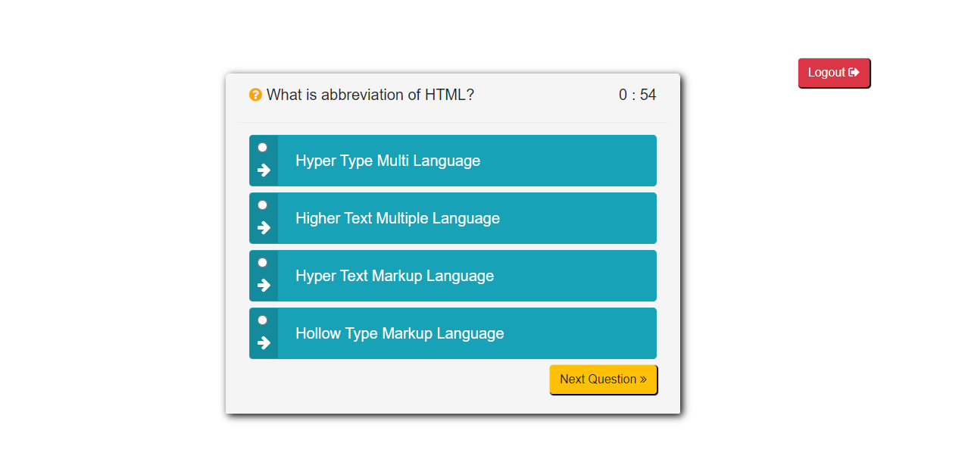
User Interfaces
Exam Page
This page displays the Questions which student has to answer.
It displays a list of multiple choice questions one by one to the student which he/she can answer in maximum one minute.
There is a button at bottom of the question to jump to the next question and one at top-right to logout.

Slide 13
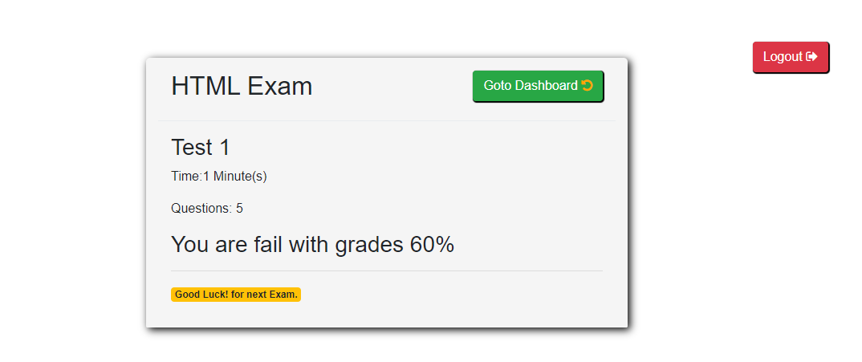
User Interfaces
Result Page
This is the page which shows the result of the exam to the user.
It shows the percentage of marks scored to the user and whether he/she is pass or fail in the test.
There are two buttons to either go back to the dashboard or to logout of the system.

Slide 14
Conclusion
Most of the basic functions of giving an exam is fulfilled and implemented. The main purpose of this project is to develop a basic online examination portal which has been completed.
.

Slide 15
Future Scope
We are planning to keep maintaining the project and improving it based on user feedback.
There are still many more features which can be added.
We will try to make user interface more interactive and user friendly.
We will try to add more passible features in the application.

Slide 16
Thank You...

